Slide 1
UNIT-V
Notes:
1

Slide 2
Ontological Engineering
1.In Toy domain – representation is not that important.
2. shopping on the Internet or driving a car in trafﬁc require moregeneral and ﬂexible representations.
3. Representation of abstract concepts is sometimes
called ontological engineering.
Ex: Events, objects, etc.
Notes:
2

Slide 3
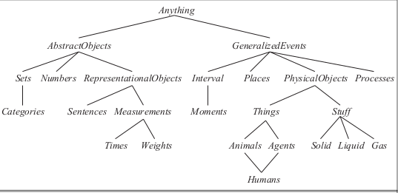
UPPER ONTOLOGY
Notes:
3

Slide 4
The ability to handle exceptions and uncertainty is extremely important.
EX:“tomatoes are red” is a useful rule, some tomatoes are green, yellow, or orange.
Notes:
4

Slide 5
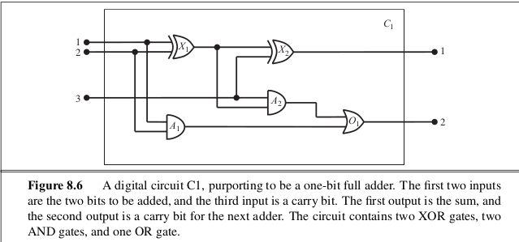
develop an ontology and knowledge base that allow us to reason about digital circuits
Notes:
5

Slide 6
Identify the task:--circuit’s functionality,timing delays,circuit area, power consumption, production cost, and so on
Assemble the relevant knowledge-wires and gates,gates: AND, OR, and XOR gates have two input terminals, and NOT gates have one. if we were interested in debugging faulty circuits, then it would probably be a good idea to include the wires in the ontology, because a faulty wire can corrupt the signal ﬂowing along it.
Notes:
6

Slide 7
CATEGORIES AND OBJECTS
Notes:
7

Slide 8
Decide on a vocabulary-choose functions,predicates, and constants to represent them
EX: Gate(X 1 ),Type(X 1 ) = XOR.
In(1, X 1 ) to denote the ﬁrst input terminal for gate X 1.
connectivity between gates can be represented by a predicate, Connected ,
which takes two terminals as arguments, as in
Connected (Out(1, X 1 ), In(1, X 2 )).
Notes:
8

Slide 9
Encode general knowledge of the domain.
1. If two terminals are connected, then they have the same signal:
1. ∀ t 1 , t 2 Terminal (t 1 ) ∧ Terminal (t 2 ) ∧ Connected (t 1 , t 2 ) ⇒Signal (t 1 ) = Signal (t 2 )
2. The signal at every terminal is either 1 or 0:
∀ t Terminal (t) ⇒ Signal (t) = 1 ∨ Signal (t) = 0 .
Notes:
9

Slide 10
Encode the speciﬁc problem instance
Circuit(C 1 ) ∧ Arity(C 1 , 3, 2)
Gate(X 1 ) ∧ Type(X 1 ) = XOR
Gate(X 2 ) ∧ Type(X 2 ) = XOR
Notes:
10

Slide 11
Pose queries to the inference procedure
What combinations of inputs would cause the ﬁrst output of C 1 (the sum bit) to be 0 and the
second output of C 1 (the carry bit) to be 1?
∃ i 1 , i 2 , i 3 Signal (In(1, C 1 )) = i 1 ∧ Signal (In(2, C 1 )) = i 2 ∧ Signal (In(3, C 1 )) = i 3 ∧ Signal (Out(1, C 1 )) = 0 ∧ Signal (Out(2, C 1 )) =1
Notes:
11

Slide 12
Debug the knowledge base
Notes:
12

Slide 13
What Is “Ontology Engineering”?
Ontology Engineering:
Ontology engineering is a set of tasks related to the development of ontologies for a particular domain.
Defining terms in the domain and relations among them
  Defining concepts in the domain (classes)
  Arranging the concepts in a hierarchy (subclass-superclass hierarchy)
  Defining which attributes and properties (slots) classes can have and constraints on their values
  Defining individuals and filling in property values
Notes:
13
13

Slide 14
Two major characteristics of general-purpose ontologies
1. A general-purpose ontology should be applicable in more or less any special-purpose domain
2. In any sufﬁciently demanding domain, different areas of knowledge must be uniﬁed.
Notes:
14

Slide 15
CATEGORIES AND OBJECTS
The organization of objects into categories is a vital part of knowledge representation.
much reasoning takes place at the level of categories.
Categories also serve to make predictions about objects once they are classiﬁed
Notes:
15

Slide 16
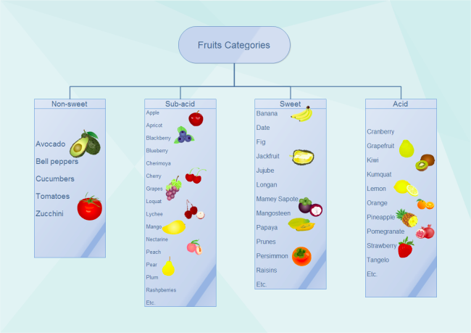
Example for categories and objects
Notes:
16

Slide 17
Reification
There are two choices for representing categories in ﬁrst-order logic.
predicates and objects.
Turning a proposition into an object is called reiﬁcation
Reification- Basketballs
Predicate- basketball(b)
Notes:
17

Slide 18
subcategory
Subset(Basketballs, Balls), abbreviated as Basketballs ⊂ Balls, to say that Basketballs is a subcategory of Balls.
Notes:
18

Slide 19
INHERITENCE
Categories serve to organize and simplify the knowledge base through inheritance.
If we say that all instances of the category Food are edible
FOOD
FRUIT
APPLE
then we can infer that every apple is edible.
Notes:
19

Slide 20
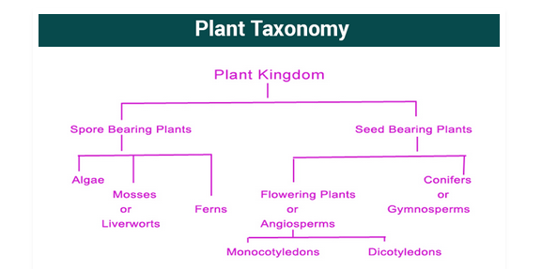
Taxonomy
Subclass relations organize categories into a taxonomy, or taxonomic hierarchy.
Notes:
20

Slide 21
Mental Events and Mental Objects
Alice asks “what is the square root of 1764” and Bob replies “I don’t know.” If Alice insists “think harder,” Bob should realize that with some more thought, this question can in fact be answered.
On the other hand, if the question were “Is your mother sitting down right now?” then Bob should realize that thinking harder is unlikely to help.Bob should realize that his mother knows whether she is sitting or not, and that asking her would be a way to ﬁnd out.
What we need is a model of the mental objects that are in someone’s head and of the mental processes that manipulate those mental objects.
Notes:
21

